Slide 1
Wednesday, May 1, 2024
Implemented Method 1 for node-centred control volume approach
Implement a 2D (template) face/neighbour/element scheme in fortran instead of using Tecplot
Current Tecplot approach doesn’t work for CLN or Quadtree
Implement kriging and rasters in pre-processor for surface elevations
Implement outer boundary import to use as mesh cookie cutter in pre-processor
Make sure all examples can be built in pre-processor

Slide 2
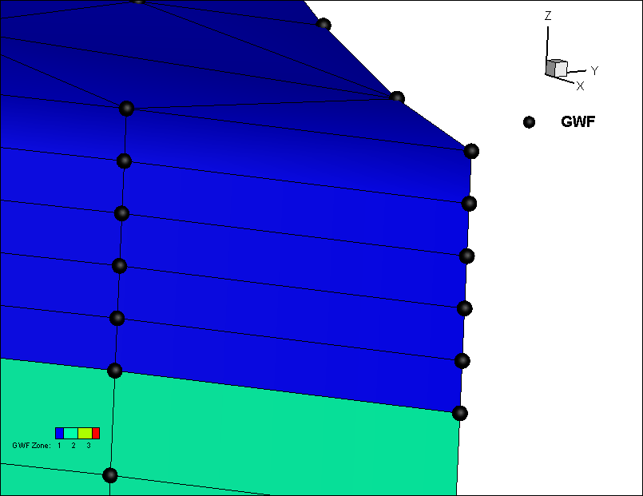
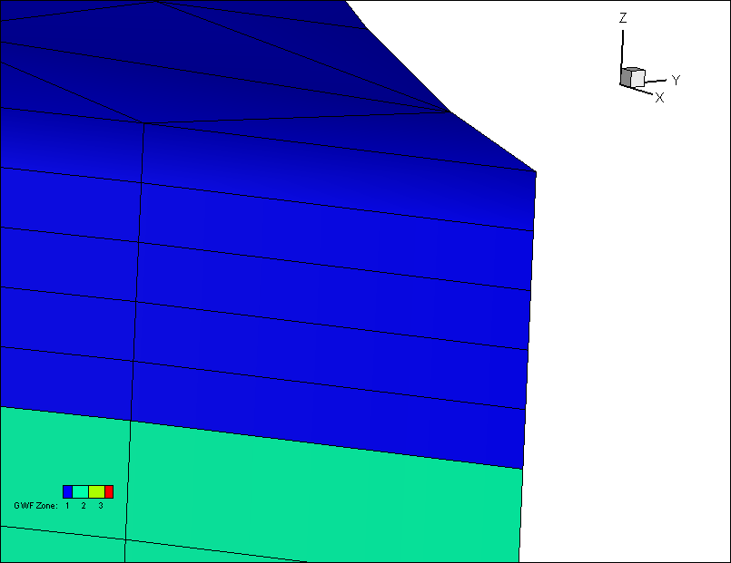
Method 1: half cell at top and bottom of domain
Can be plotted directly in Tecplot because number of cells equals number of nodes
Method 2: full cells
Layer 1
Top
Top
Layer 2
Bottom
Layer 1
Layer 2
Bottom

Slide 3
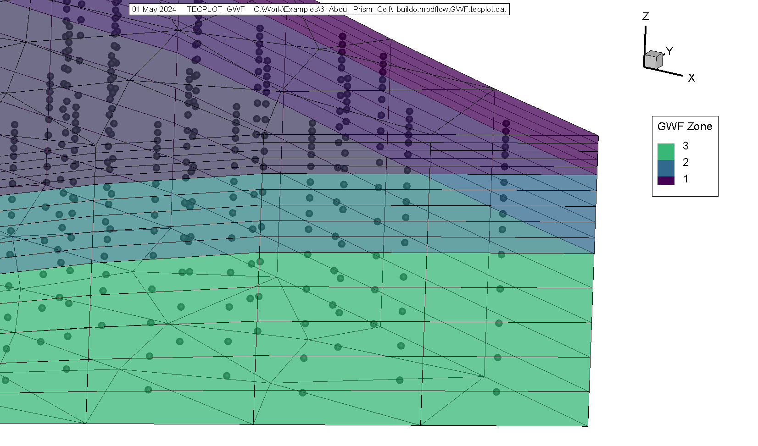

Slide 4
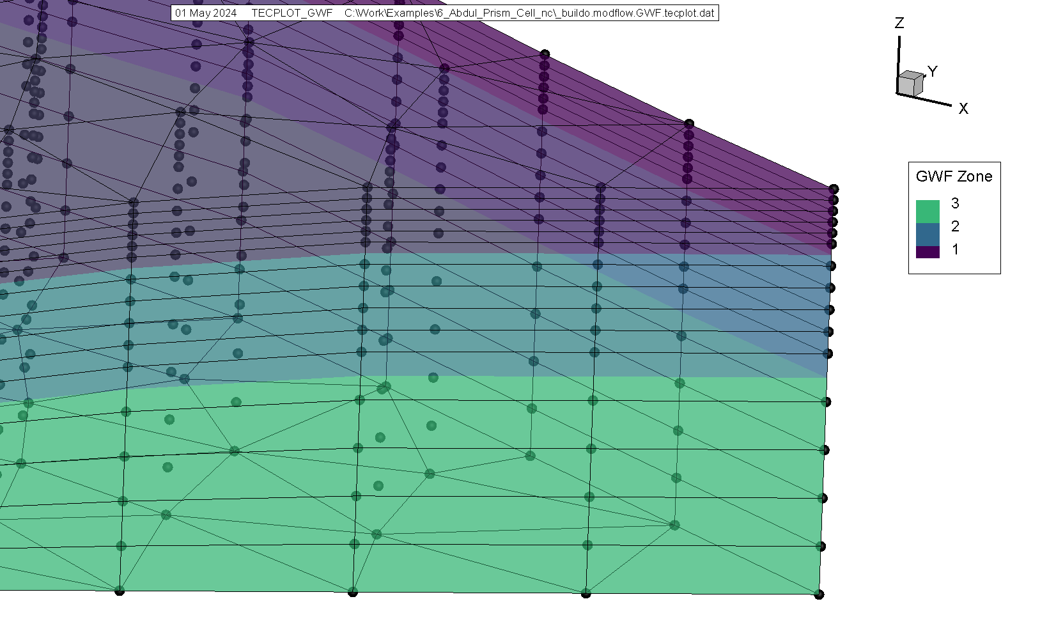

Slide 5
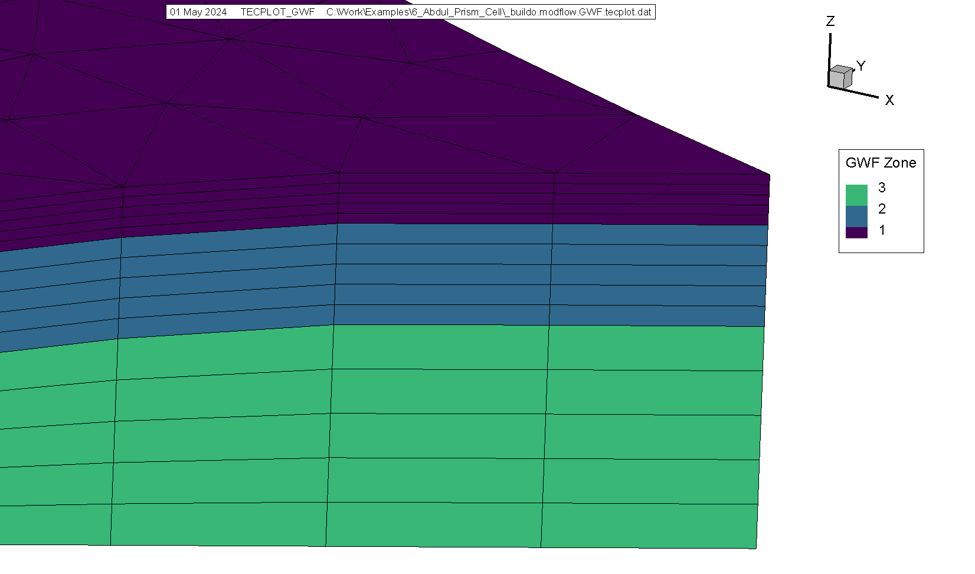

Slide 6


Slide 7
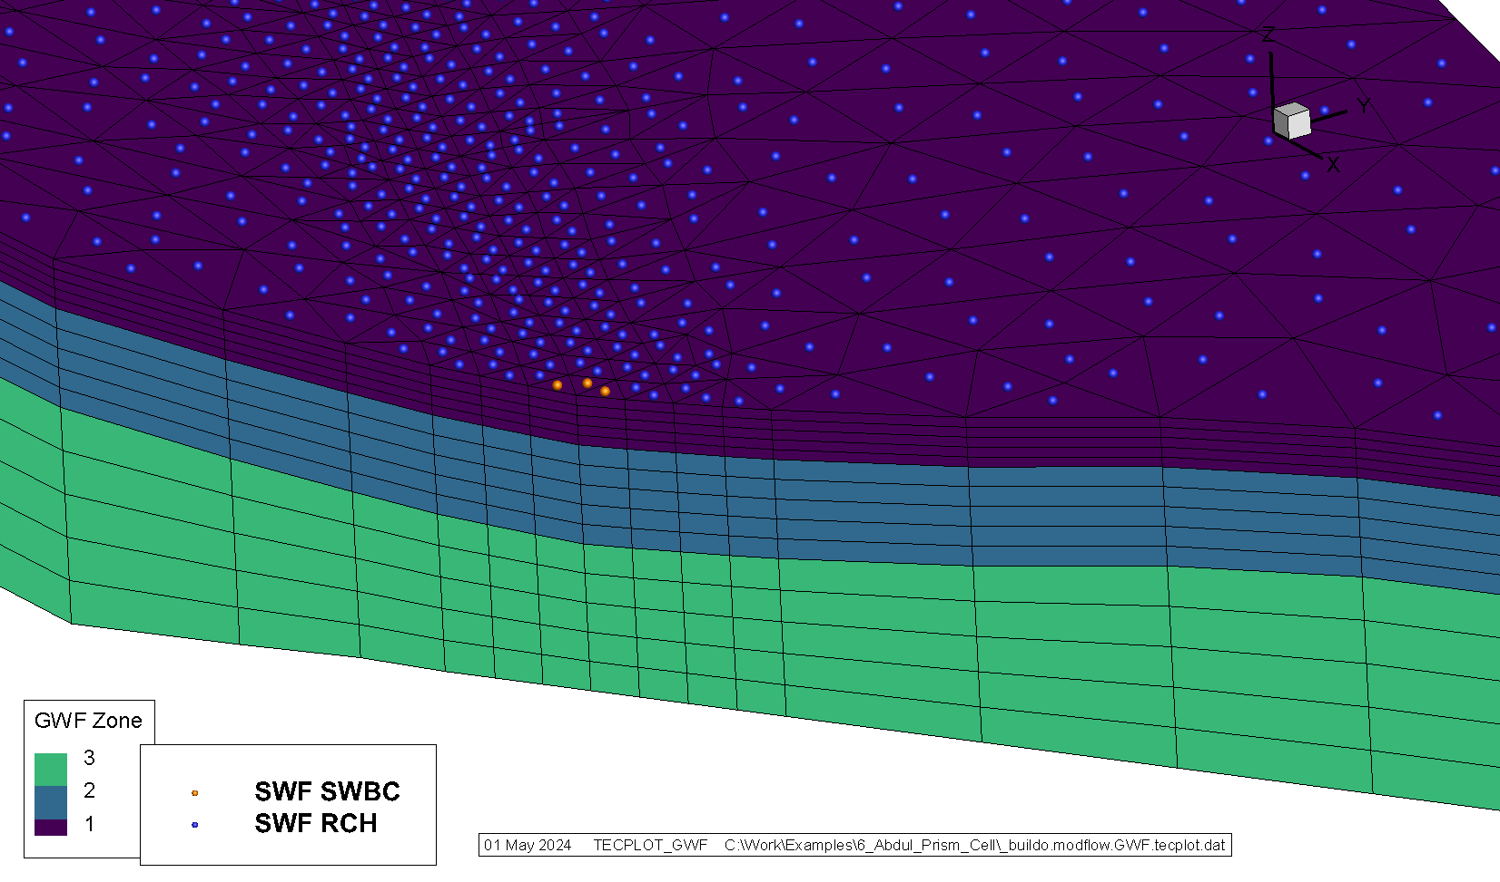

Slide 8
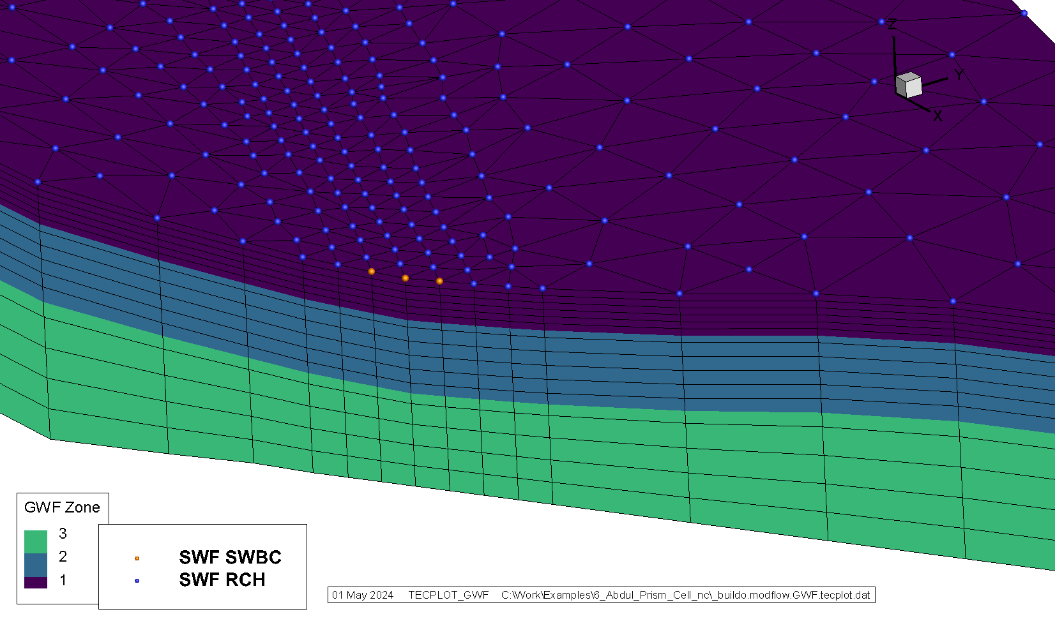

Slide 9
